Slide 1

Cluster Architecture
Web Search for a Planet and much more….
Abhijeet Desai
desaiabhijeet89@gmail.com

Slide 2
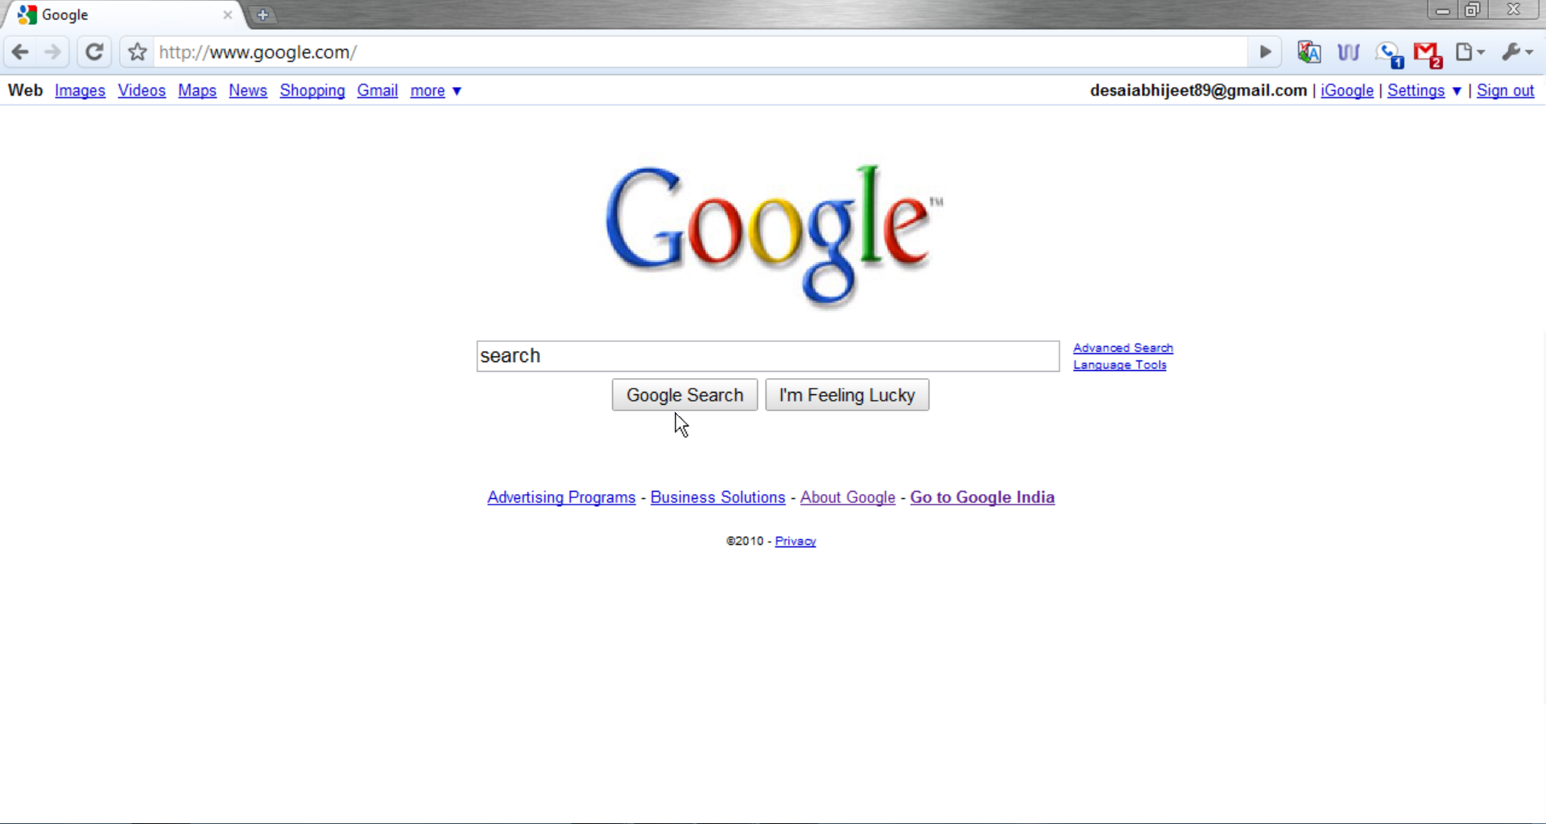

Slide 3
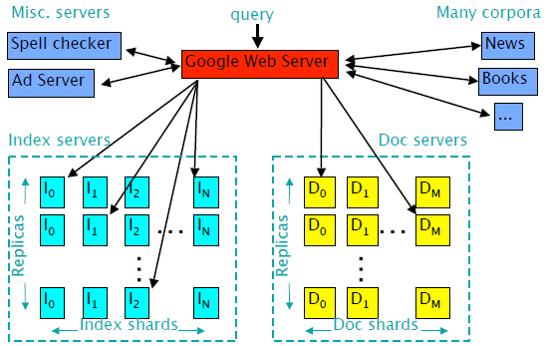
Google Query Serving Infrastructure
Elapsed time: 0.25s, machines involved: 1000s+

Slide 4
PageRank
PageRankTM is the core technology to measure the importance of a page
Google's theory
– If page A links to page B
# Page B is important
# The link text is irrelevant
– If many important links point to page A
# Links from page A are also important

Slide 5
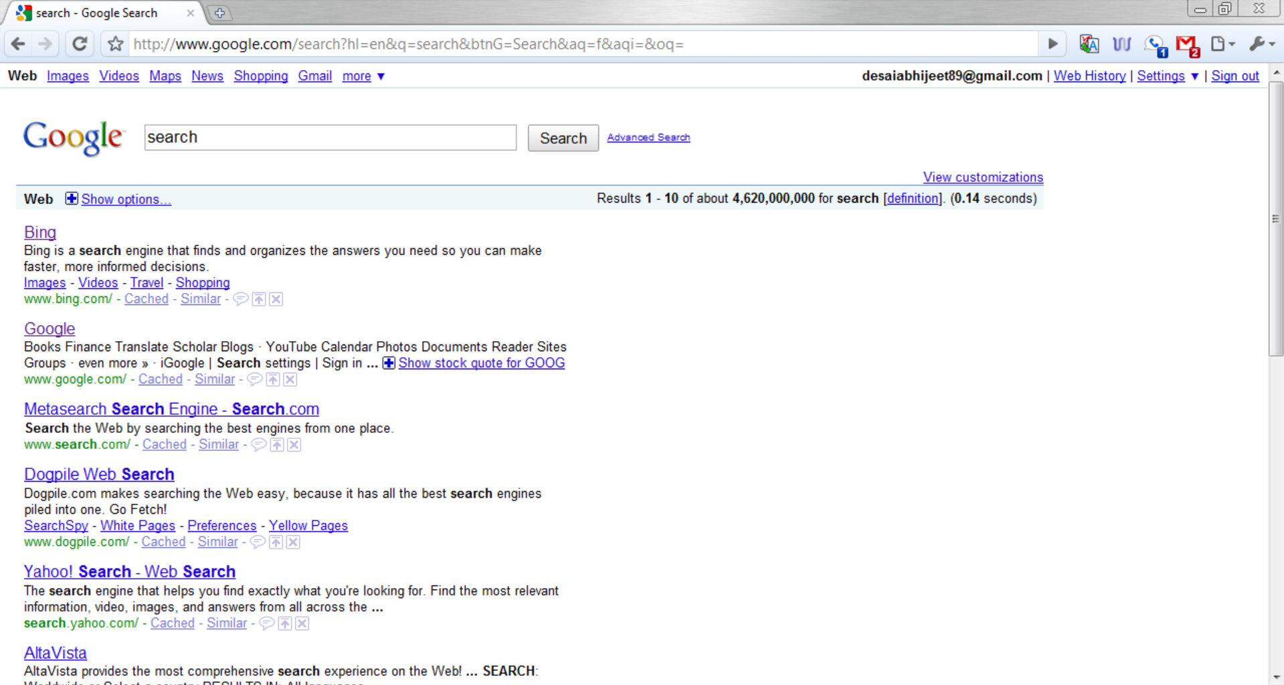

Slide 6
Key Design Principles
Software reliability
Use replication for better request throughput and availability
Price/performance beats peak performance
Using commodity PCs reduces the cost of computation

Slide 7
The Power Problem
High density of machines (racks)
– High power consumption 400-700 W/ft2
# Typical data center provides 70-150 W/ft2
# Energy costs
– Heating
# Cooling system costs
Reducing power
– Reduce performance (c/p may not reduce!)
– Faster hardware depreciation (cost up!)

Slide 8
Parallelism
Lookup of matching docs in a large index
--> many lookups in a set of smaller indexes followed by a merge step
A query stream
--> multiple streams
(each handled by a cluster)
Adding machines to a pool increases serving capacity

Slide 9
Hardware Level Consideration
Instruction level parallelism does not help
Multiple simple, in-order, short-pipeline core
Thread level parallelism
Memory system with moderate sized L2 cache is enough
Large shared-memory machines are not required to boost the performance

Slide 10
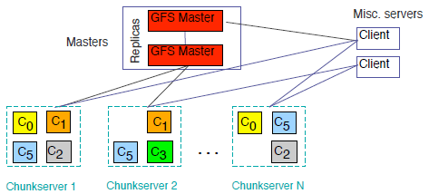
GFS (Google File System) Design
Master manages metadata
Data transfers happen directly between clients/chunk servers
Files broken into chunks (typically 64 MB)

Slide 11
GFS Usage @ Google
• 200+ clusters
• Many clusters of 1000s of machines
• Pools of 1000s of clients
• 4+ PB Filesystems
• 40 GB/s read/write load
– (in the presence of frequent HW failures)

Slide 12
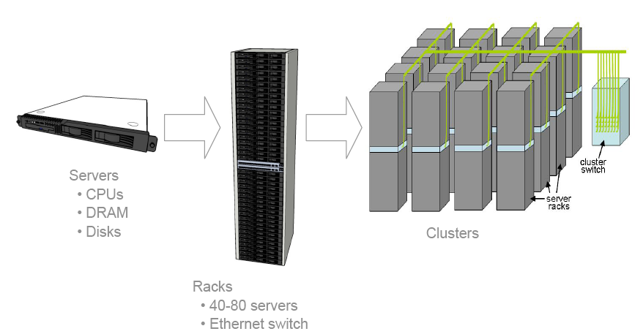
The Machinery

Slide 13
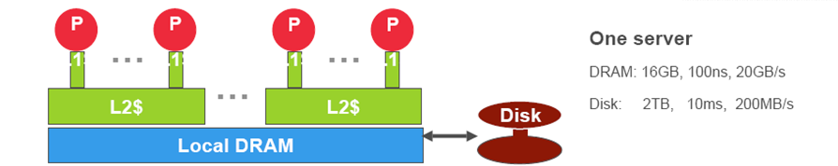
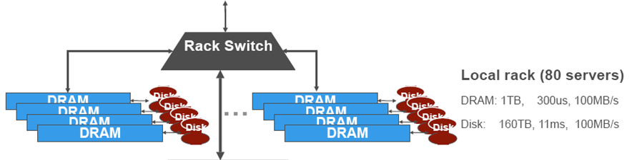
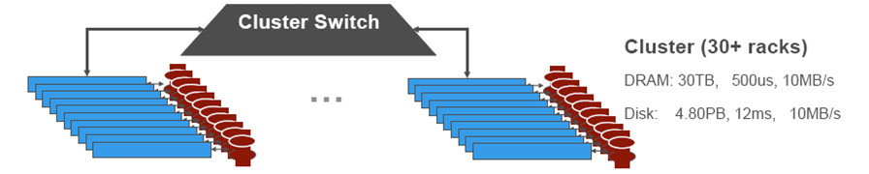
Architectural view of the storage hierarchy

Slide 14
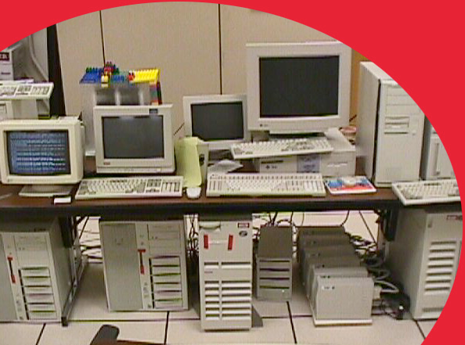
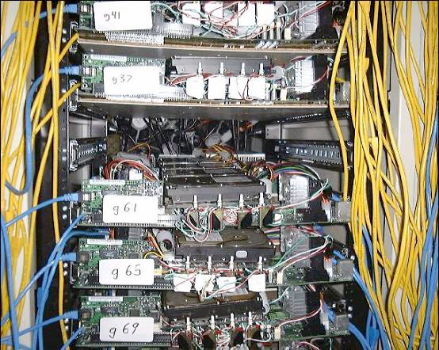
Clusters through the years
“Google” Circa 1997 (google.stanford.edu)
Google (circa 1999)

Slide 15
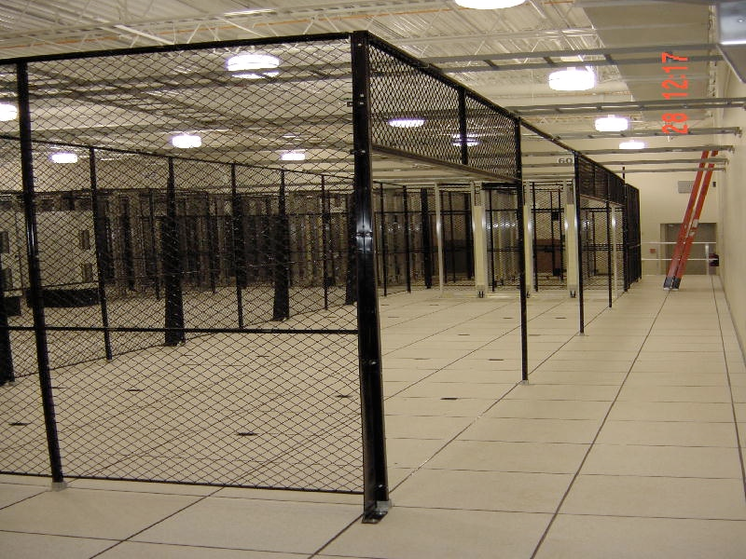
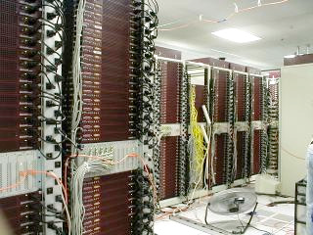
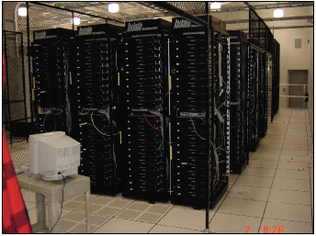
Clusters through the years
Google (new data center 2001)
Google Data Center (Circa 2000)
3 days later

Slide 16
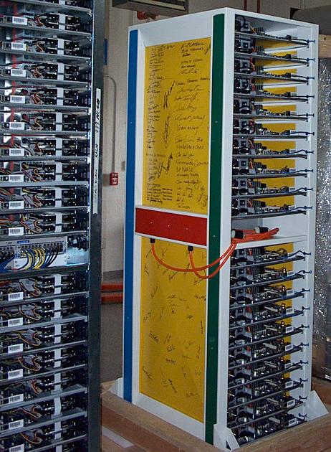
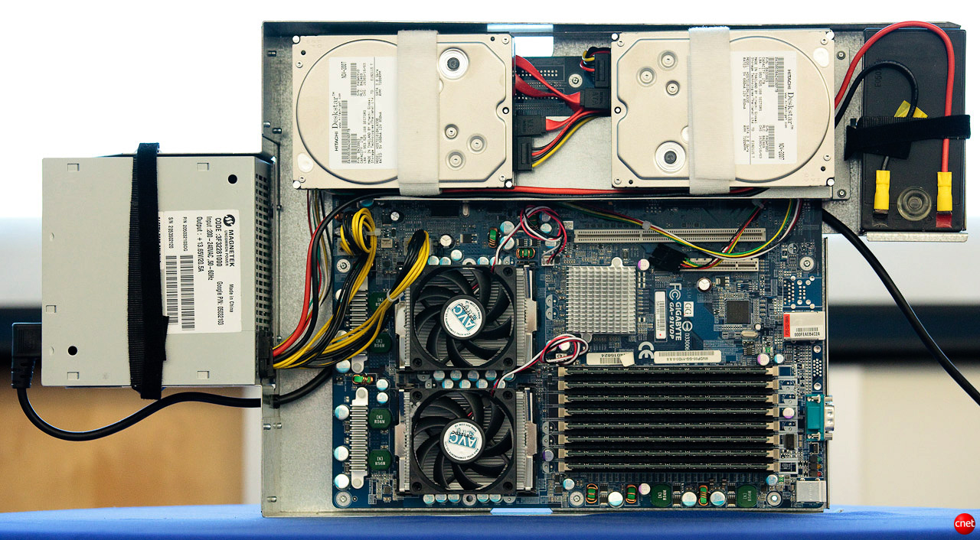
Current Design
• In-house rack design
• PC-class motherboards
• Low-end storage and networking hardware
• Linux
• + in-house software

Slide 17
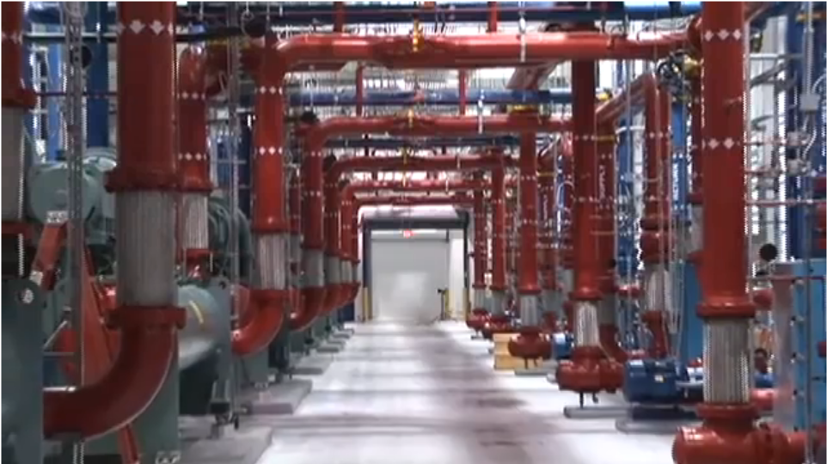
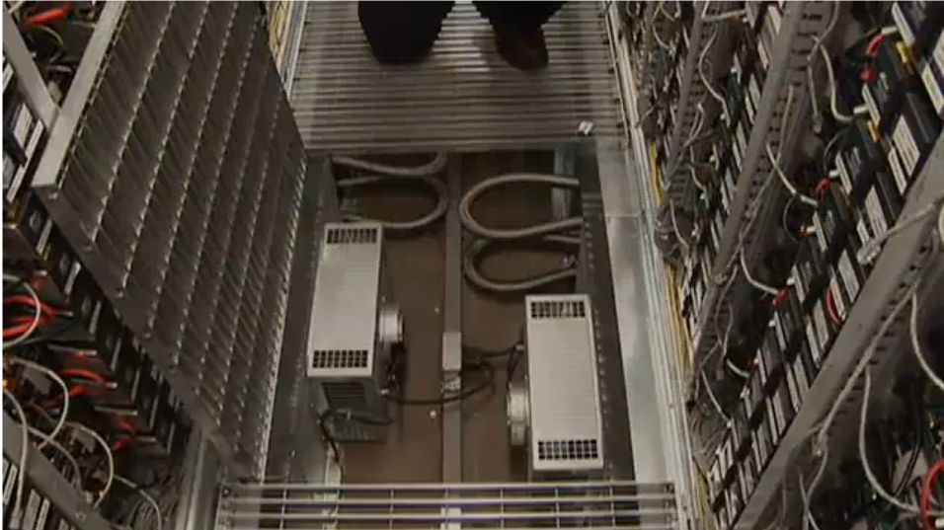
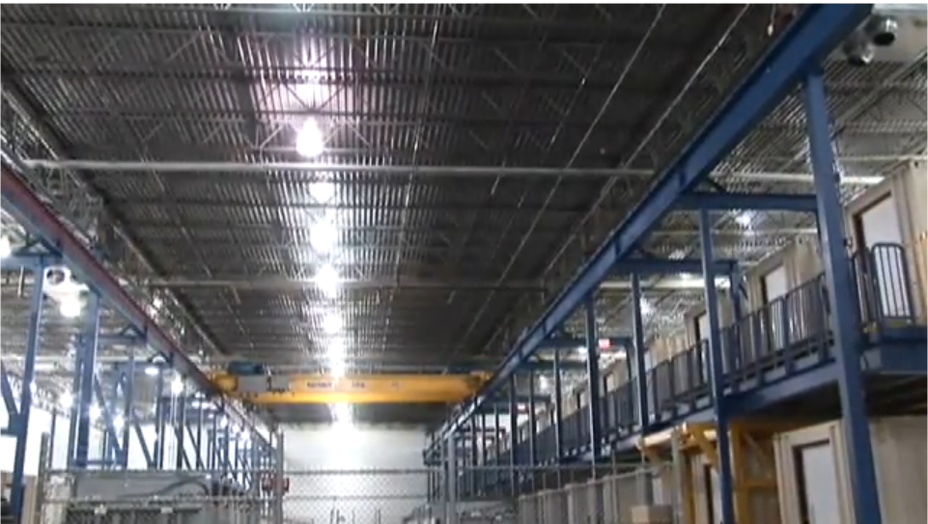
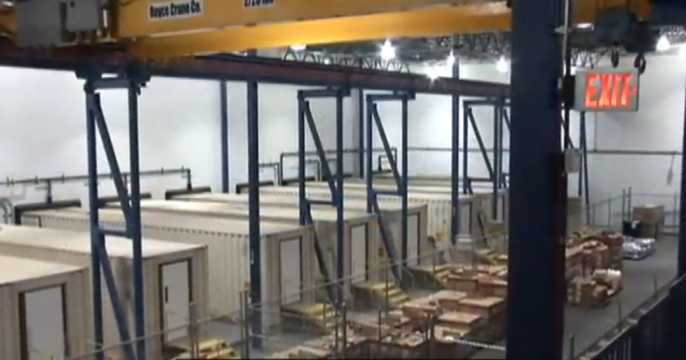
Container Datacenter

Slide 18
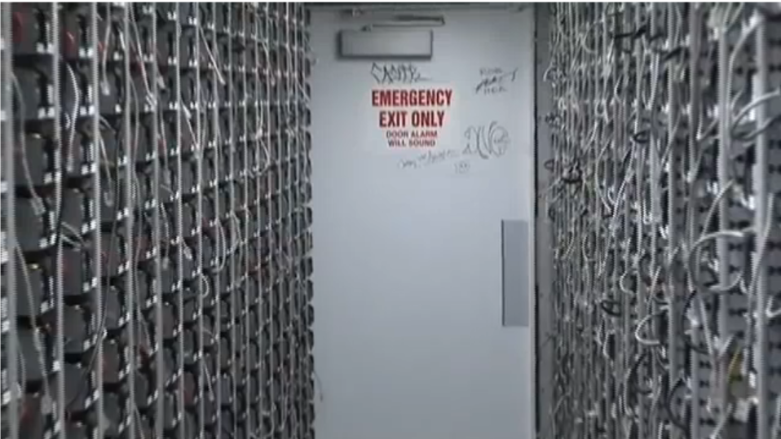
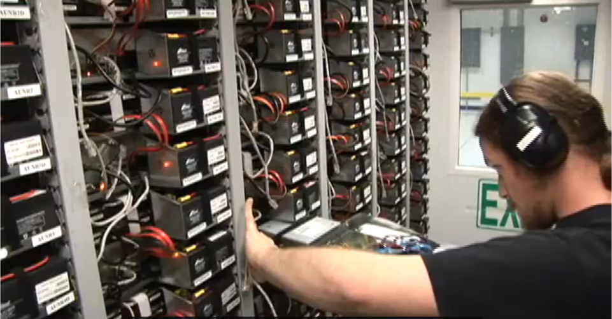
Container Datacenter

Slide 19
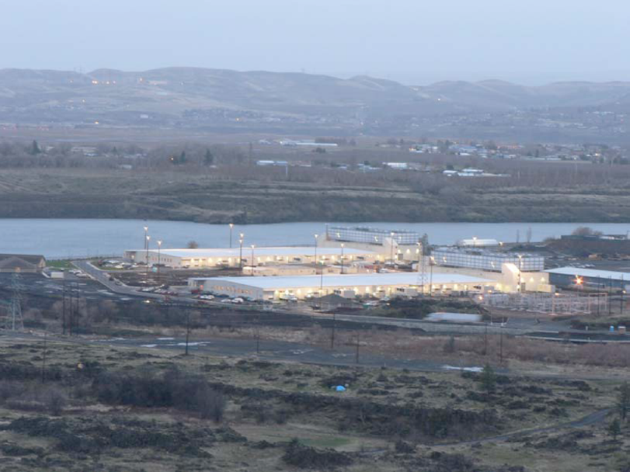
Multicore Computing

Slide 20
Comparison Between Custom built & High-end Servers
 | Typical x86 - based server | Custom built x86 - based server
PROCESSORS | 8 2-GHz Xeon CPUs | 176 2-GHz Xeon CPUs | 22x
RAM | 64 Gbytes of RAM | 176 Gbytes of RAM | 3x
DISK SPACE | 8 Tbytes of disk space | 7 Tbytes of disk space | -1 TB
PRICE | $758,000 | $278,000 | $480,000

Slide 21
Implications of the Computing Environment
Stuff Breaks
• If you have one server, it may stay up three years (1,000 days)
• If you have 10,000 servers, expect to lose ten a day
• “Ultra-reliable” hardware doesn’t really help
• At large scale, super-fancy reliable hardware still fails, albeit less often
– software still needs to be fault-tolerant
– commodity machines without fancy hardware give better performance/$
• Reliability has to come from the software
• Making it easier to write distributed programs

Slide 22
Infrastructure for Search Systems
Several key pieces of infrastructure:
– GFS
– MapReduce
– BigTable

Slide 23
MapReduce
• A simple programming model that applies to many large-scale computing problems
• Hide messy details in MapReduce runtime library:
– automatic parallelization
– load balancing
– network and disk transfer
optimizations
– handling of machine failures
– robustness
– improvements to core library benefit all users of library!

Slide 24
Typical problem solved by MapReduce
• Read a lot of data
• Map: extract something you care about from each record
• Shuffle and Sort
• Reduce: aggregate, summarize, filter, or transform
• Write the results
• Outline stays the same, map and reduce change to fit the problem

Slide 25
Conclusions
For a large scale web service system like Google
– Design the algorithm which can be easily parallelized
– Design the architecture using replication to achieve distributed computing/storage and fault tolerance
– Be aware of the power problem which significantly restricts the use of parallelism

Slide 26
References
1. Luiz André Barroso , Jeffrey Dean , Urs Hölzle, Web Search for a Planet: The Google Cluster Architecture, IEEE Micro, v.23 n.2, p.22-28, March 2003 [doi>10.1109/MM.2003.1196112]
2. S. Brin and L. Page, “The Anatomy of a Large-Scale Hypertextual Web Search Engine,” Proc. Seventh World Wide Web Conf. (WWW7), International World Wide Web Conference Committee (IW3C2), 1998, pp. 107-117.
3. “TPC Benchmark C Full Disclosure Report for IBM eserver xSeries 440 using Microsoft SQL Server 2000 Enterprise Edition and Microsoft Windows .NET Datacenter Server 2003, TPC-C Version 5.0,” http://www.tpc.org/results/FDR/TPCC/ibm.x4408way.c5.fdr.02110801.pdf.
4. D. Marr et al., “Hyper-Threading Technology Architecture and Microarchitecture: A Hypertext History,” Intel Technology J., vol. 6, issue 1, Feb. 2002.
5. L. Hammond, B. Nayfeh, and K. Olukotun, “A Single-Chip Multiprocessor,” Computer, vol. 30, no. 9, Sept. 1997, pp. 79-85.
6. L.A. Barroso et al., “Piranha: A Scalable Architecture Based on Single-Chip Multiprocessing,” Proc. 27th ACM Int’l Symp. Computer Architecture, ACM Press, 2000, pp. 282-293.
7. L.A. Barroso, K. Gharachorloo, and E. Bugnion, “Memory System Characterization of Commercial Workloads,” Proc. 25th ACM Int’l Symp. Computer Architecture, ACM Press, 1998, pp. 3-14.

